Slide 1

Chapter
3
Collecting Information and Forecasting Demand

Slide 2


Learning Objectives
What are the components of a modern marketing information system?
What are useful internal records for a marketing information system?
What makes up a marketing intelligence system?
What are some influential macroenvironment developments?
How can companies accurately measure and forecast demand

Slide 3
Components of a
Modern Marketing
Information System (MIS)
  Internal company records
Marketing intelligence activities
Marketing research
Notes:
A marketing information system (MIS) consists of people, equipment, and procedures to gather, sort, analyze,
evaluate, and distribute needed, timely, and accurate information to marketing decision makers. It relies on internal company records, marketing intelligence activities, and marketing research.
The company’s marketing information system should combine what managers think they need, what they really need, and what is economically feasible.

Slide 4

Internal records
Internal reports of orders
Sales
Prices
Costs
Inventory levels
Receivables
Payables
Notes:
Internal records use the order-to-payment cycle, sales information systems, databases, data warehousing, and data mining to obtain this list of information.

Slide 5

Marketing intelligence
Marketing intelligence system: a set of procedures and sources that managers use to obtain everyday information about developments in the marketing environment
Notes:
The internal records system supplies results data, but the marketing intelligence system supplies happenings data. Marketing managers collect marketing intelligence by reading books, newspapers, and trade publications; talking to customers, suppliers, distributors, and other company managers; and monitoring online social media.

Slide 6
Improving marketing intelligence
  Motivate sales force to report new developments
  Motivate intermediaries to pass along intelligence
  Hire external experts to collect intelligence
  Network internally and externally
  Set up a customer advisory panel
  Take advantage of government-related data
  Purchase information from outside research vendors
  Collect marketing intelligence on Internet
Notes:
Marketing intelligence gathering must be legal and ethical.

Slide 7
Marketing Intelligence on the internet
Independent customer goods and service review forums
Distributor or sales agent feedback sites
Combo sites offering customer reviews and expert opinions
Customer complaint sites
Public blogs
Notes:
Of course, companies can use many of these sources to monitor their own customers, products, services,and brands. Customer-service forums linked on a company’s home page are a very useful tool. Customers often
Respond faster and provide better answers to other customers than a company could.

Slide 8
Communicating & Acting on Marketing intelligence
The competitive intelligence function works best when it is closely coordinated with the decision-making process
  Given the speed of the Internet, it is important to act quickly on information gleaned online
Notes:
When ticket broker StubHub detected criticism of its brand after confusion arose about refunds for a raindelayed Yankees–Red Sox game, it quickly offered appropriate discounts and credits. The director of customer service observed, “This [episode] is a canary in a coal mine for us.”

Slide 9
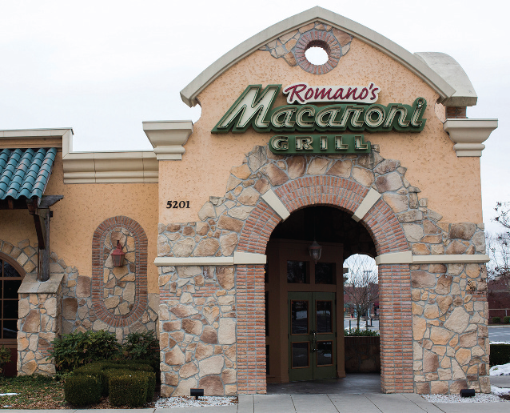
Analyzing the Macroenvironment
Needs and Trends
  Fad
  Trend
  Megatrend
Notes:
A fad is “unpredictable, short-lived, and without social, economic, and political significance.” A direction or sequence of events with momentum and durability, a trend is more predictable and durable than a fad; trends reveal the shape of the future and can provide strategic direction. A megatrend is a “large social, economic, political, and technological change [that] is slow to form, and once in place, influences us for some time—between seven and ten years, or longer.”

Slide 10
Identifying the
Major Forces
Six major forces in the broad environment
Demographic
Natural
Economic
Technological
Socio-cultural
Political-legal
Notes:
Firms must monitor six major forces in the broad environment: demographic, economic, social-cultural, natural, technological, and political-legal. Their interactions will lead to new opportunities and threats.

Slide 11

The Demographic Environment
Worldwide population growth
Population age mix
Ethnic and other markets
Educational groups
Household patterns
Notes:
World population growth is explosive: The world’s population on July 1, 2012, was estimated at 7,027,349,193, forecasted to rise to 8.82 billion by 2040 and exceed 9 billion by 2045.
There is a global trend toward an aging population. In 1950, there were only 131 million people 65 and older;
in 1995, their number had almost tripled to 371 million. By 2050, one of 10 people worldwide will be 65 or older. Marketers generally divide the population into six age groups: preschool children, school-age children, teens,
young adults age 20 to 40, middle-aged adults 40 to 65, and older adults 65 and older. Some marketers focus on
cohorts, groups of individuals born during the same time period who travel through life together.
Ethnic and racial diversity varies across countries. As of the 2010 Census, the U.S. population was: White (72 percent), Black or African American (13 percent), American Indian and Alaskan Native (0.9 percent), Asian (5 percent), Hispanic (16 percent). More than half the growth between 2000 and 2010 came from the increase in the
Hispanic population, which grew by 43 percent, from 35.3 million to 50.5 million, representing a major shift
in the nation’s ethnic center of gravity.
The population in any society falls into five educational groups: illiterates, high school dropouts, high school diplomas, college degrees, and professional degrees. The United States has one of the world’s highest percentages of college-educated citizens. The large number of educated people in the United States drives strong demand for high-quality books, magazines, and travel and creates a supply of skills.
The traditional U.S. household included a husband, wife, and children under 18 (sometimes with grandparents). The U.S. family has been steadily evolving toward less traditional forms. More people are divorcing, separating,
choosing not to marry, or marrying later. Each type of household has distinctive needs and buying habits.

Slide 12
The Economic Environment
CONSUMER PSYCHOLOGY
INCOME DISTRIBUTION
INCOME, SAVINGS, DEBT, CREDIT
Notes:
Purchasing power depends on consumers’ income, savings, debt, and credit availability as well as the price level.
As the recent economic downturn vividly demonstrated, fluctuating purchasing power strongly affects business, especially for products geared to high-income and price-sensitive consumers. Marketers must understand consumer psychology and levels and distribution of income, savings, debt, and credit.

Slide 13
Income distribution
Subsistence economies
Raw-material-exporting economies
Industrializing economies
Industrial economies
Very low incomes
Mostly low incomes
Very low, very high incomes
Low, medium, high incomes
Mostly medium incomes
Notes:
High-priced Lamborghini sports cars have found success in relatively poorer countries by appealing to enough affluent buyers.

Slide 14
The Sociocultural Environment
Views of ourselves
Views of society
Views of others
Views of nature
Views of organizations
Views of the universe
Notes:
From our sociocultural environment we absorb, almost unconsciously, a world view that defines our relationships to ourselves, others, organizations, society, nature, and the universe.

Slide 15
The Sociocultural Environment
Core cultural values
  Values are passed from parents to children and reinforced by social institutions
Subcultures
  Groups with shared values, beliefs, preferences, and behaviors emerging from their special life experiences or circumstances
Notes:
Most people in the United States still believe in working, getting married, giving to charity, and being honest. Although core values are fairly persistent, cultural swings do take place.
Marketers have always loved teenagers because they are trendsetters in fashion, music, entertainment, ideas, and attitudes. Attract someone as a teen, and you will likely keep the person as a customer later in life.

Slide 16
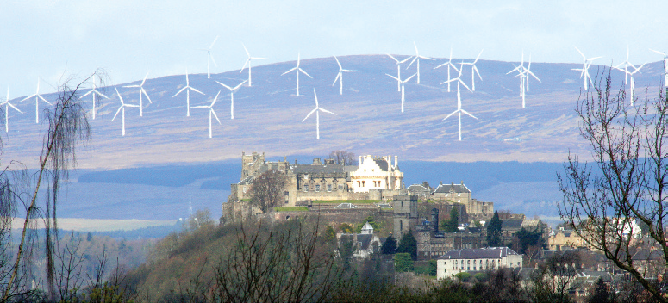
The natural environment
Corporate environmentalism
  Opportunities await those who can reconcile prosperity with environmental protection
Notes:
Corporate environmentalism recognizes the need to integrate environmental issues into the firm’s strategic plans. Trends for marketers to be aware of include the shortage of raw materials, especially water; the increased cost of energy; increased pollution levels; and the changing role of governments.

Slide 17
The Technological Environment
Accelerating pace of change
Unlimited opportunities
for innovation
Varying R&D budgets
Increased regulation of technological change
Notes:
In many markets, the next technological breakthrough seems right around the corner.
Medical researchers hope to use stem cells for organ generation and hybrid positron emission tomography (PET) and magnetic resonance imaging (MRI) to dramatically improve diagnosis. Environmental researchers are exploring plasma arc waste disposal to harness lightning and turn garbage into glass or a gaseous energy source.
A growing portion of U.S. R&D, however, goes to the development side, not research, raising concerns about
whether the United States can maintain its lead in basic science. Too many companies seem to be putting their
money into copying competitors’ products with minor improvements.
Government has expanded its agencies’ powers to investigate and ban potentially unsafe products. Safety and health regulations have increased for food, automobiles, clothing, electrical appliances, and construction.

Slide 18
The Political-Legal Environment
LAWS
GOVERNMENT AGENCIES
PRESSURE GROUPS
Notes:
Two major trends are increased business legislation and the growth of special-interest groups.
The European Commission has established new laws covering competitive behavior, product standards, product
liability, and commercial transactions for the 28 member nations of the European Union. The United States has
many consumer protection laws covering competition, product safety and liability, fair trade and credit practices,
and packaging and labeling, but many countries’ laws are stronger.
The consumerist movement organized citizens and government to strengthen the rights and powers of buyers
in relationship to sellers. Consumerists have won the right to know the real cost of a loan, the true cost per
Standard unit of competing brands (unit pricing), the basic ingredients and true benefits of a product, and the
nutritional quality and freshness of food. Privacy issues and identity theft will remain public policy hot buttons as long as consumers are willing to swap personal information for customized products—from marketers they trust

Slide 19
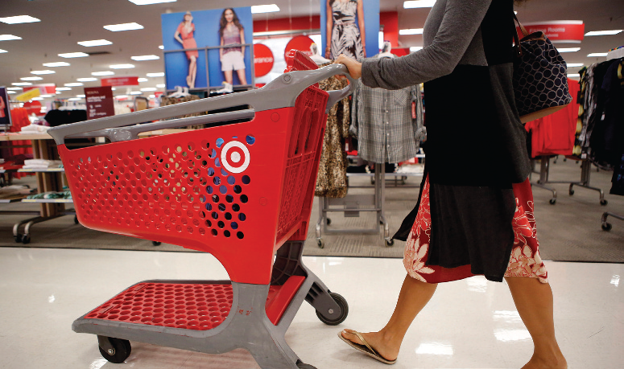
Forecasting and Demand
Measurement
Market demand measures
  Potential market
  Available market
  Target market
  Penetrated market
Notes:
The potential market is the set of consumers with a sufficient level of interest in a market offer.
The available market is the set of consumers who have interest, income, and access to a particular offer. Eligible adults constitute the qualified available market—the set of consumers who have interest, income, access, and qualifications for the market offer.
The target market is the part of the qualified available market the company decides to pursue.
The penetrated market is the set of consumers who are buying the company’s product.

Slide 20
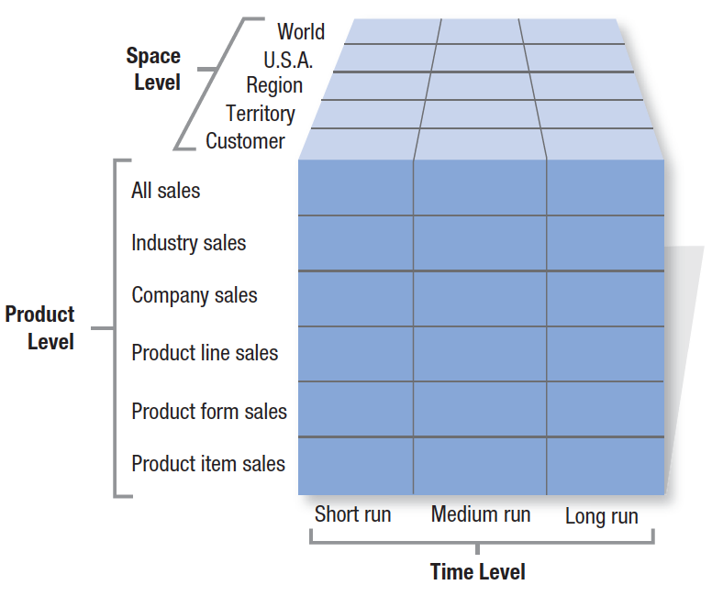
Figure 3.1
Ninety Types of Demand Measurement

Slide 21
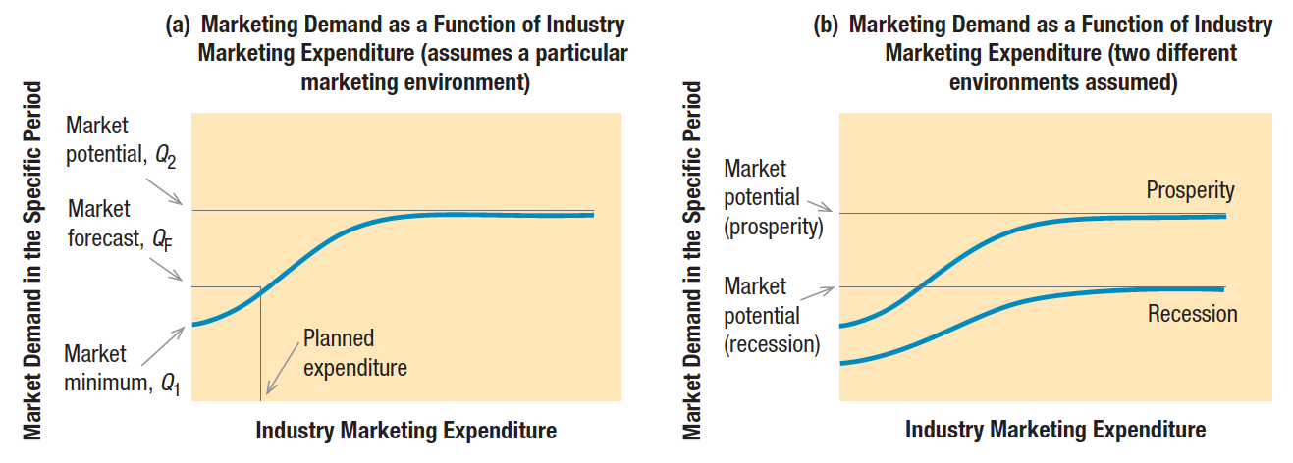
Demand measurement vocabulary
Market demand (Figure 3.2)
Notes:
The marketer’s first step in evaluating marketing opportunities is to estimate total market demand. Market demand for a product is the total volume that would be bought by a defined customer group in a defined geographical area in a defined time period in a defined marketing environment under a defined marketing program.
The horizontal axis shows different possible levels of industry marketing expenditure in a given time period. The vertical axis shows the resulting demand level. The curve represents the estimated market demand associated with varying levels of marketing expenditure.

Slide 22

Market demand vocabulary
Market share
Market-penetration index
Share-penetration index
Notes:
Market share is a higher level of selective demand for a company’s product.
It pays to compare the current and potential levels of market demand. The result is the market-penetration index.
A low index indicates substantial growth potential for all the firms. A high index suggests it will be expensive to attract the few remaining prospects. Generally, price competition increases and margins fall when the market-penetration index is already high.
Comparing current and potential market shares yields a firm’s share-penetration index. If this index is low, the company can greatly expand its share. Holding it back could be low brand awareness, low availability, benefit
Deficiencies, or high price. A firm should calculate the share-penetration increases from removing each factor to
see which investments produce the greatest improvement.

Slide 23
Demand measurement vocabulary
Market forecast
Market potential
Company demand
Company sales forecast
Company sales potential
Notes:
Only one level of industry marketing expenditure will actually occur. The market demand corresponding to this level is called the market forecast.
Market potential is the limit approached by market demand as industry marketing expenditures approach infinity for a given marketing environment. Companies interested in market potential have a special interest in the product-penetration percentage, the percentage of ownership or use of a product or service in a population. The lower the product-penetration percentage, the higher the market potential, although this also assumes everyone will eventually be in the market for every product.
Company demand is the company’s estimated share of market demand at alternative levels of company marketing effort in a given time period.
The company sales forecast is the expected level of company sales based on a chosen marketing plan and an assumed marketing environment. A sales quota is the sales goal set for a product line, company division,
or sales representative. A sales budget is a conservative estimate of the expected volume of sales, primarily for making current purchasing, production, and cash flow decisions.
Company sales potential is the sales limit approached by company demand as company marketing effort increases relative to that of competitors. The absolute limit of company demand is, of course, the market potential.

Slide 24
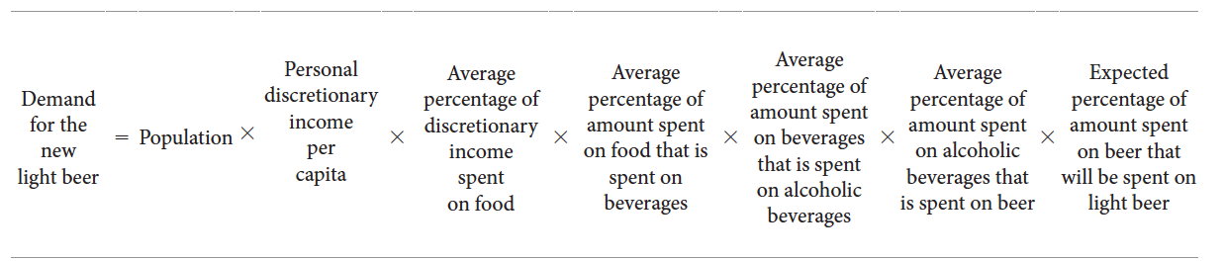
Estimating Current Demand
Total market potential
  Chain-ratio method
Notes:
Total market potential is the maximum sales available to all firms in an industry during a given period, under a given level of industry marketing effort and environmental conditions. A common way to estimate total market potential is to multiply the potential number of buyers by the average quantity each purchases and then by the price. A variation on this method is the chain-ratio method, which multiplies a base number by several adjusting percentages.

Slide 25
Estimating Current Demand
Area market potential
  Market-buildup method
  Multiple-factor index method
Notes:
Because companies must allocate their marketing budget optimally among their best territories, they need to estimate the market potential of different cities, states, and nations. Two major methods are the market-buildup method, used primarily by business marketers, and the multiple-factor index method, used primarily by consumer marketers.
The market-buildup method calls for identifying all the potential buyers in each market and estimating their potential purchases. It produces accurate results if we have a list of all potential buyers and a good estimate of what each will buy. Unfortunately, this information is not always easy to gather.
Like business marketers, consumer companies also need to estimate area market potentials, but because their customers are too numerous to list, they commonly use a straightforward index.

Slide 26
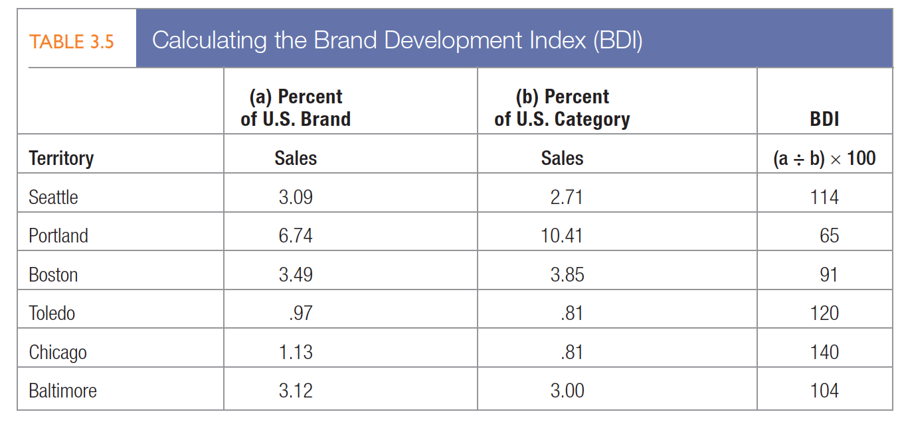
brand development index (BDI)
Table 3.5
Notes:
Many companies compute area indexes to allocate marketing resources. Suppose the drug company is reviewing
the six cities listed in Table 3.5. The first two columns show its percentage of U.S. brand and category sales in these six cities. Column 3 shows the brand development index (BDI), the index of brand sales to category sales.
Seattle has a BDI of 114 because the brand is relatively more developed than the category in Seattle. Portland’s BDI is 65, which means the brand is relatively underdeveloped there.

Slide 27

Estimating Current Demand
Industry sales and market share
Notes:
Besides estimating total potential and area potential, a company needs to know the actual industry sales taking place in its market. This means identifying competitors and estimating their sales. The industry trade association will often collect and publish total industry sales, although it usually does not list individual company sales separately. Another way to estimate sales is to buy reports from a marketing research firm that audits total sales and brand sales.

Slide 28
Estimating future demand
Survey of buyers’ intentions
  Forecasting and purchase probability scale
Composite of sales force opinions
Expert opinion
Past-sales analysis
Market-test method
Notes:
All forecasts are built on one of three information bases: what people say, what people do, or what people have
done. Using what people say requires surveying buyers’ intentions, composites of sales force opinions, and expert opinion. Building a forecast on what people do means putting the product into a test market to measure buyer response. To use the final basis—what people have done—firms analyze records of past buying behavior or use time-series analysis or statistical demand analysis.
Forecasting is the art of anticipating what buyers are likely to do under a given set of conditions. For major consumer durables such as appliances, research organizations conduct periodic surveys of consumer buying intentions, ask questions like Do you intend to buy an automobile within the next six months?, and put the answers on a purchase probability scale.

Slide 29
